Slide 1


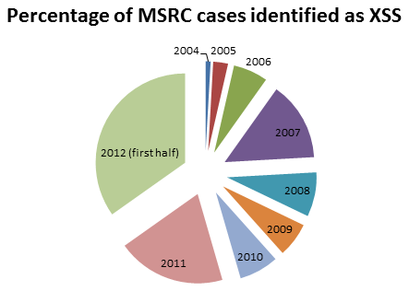
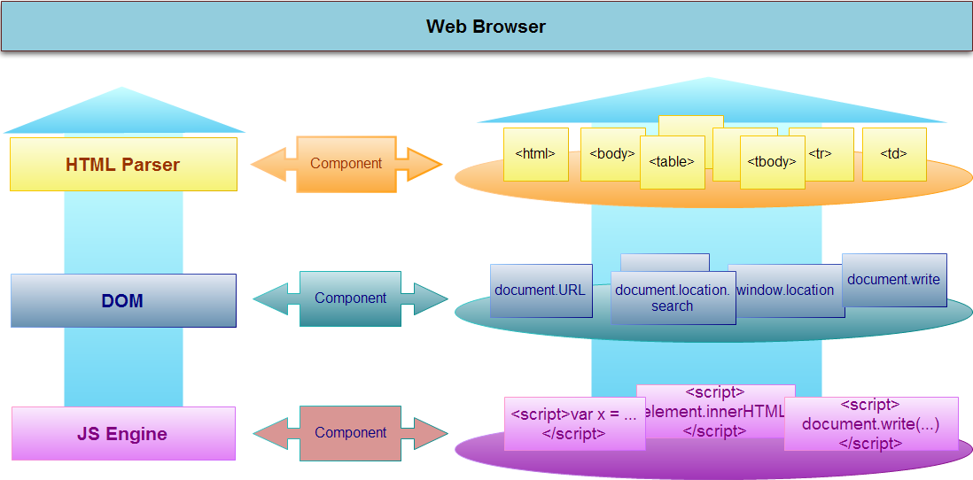
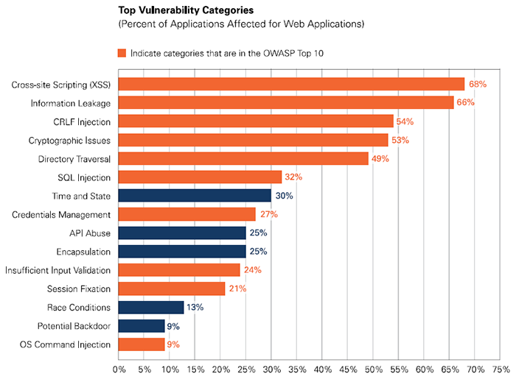

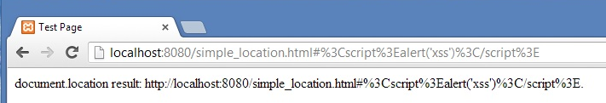


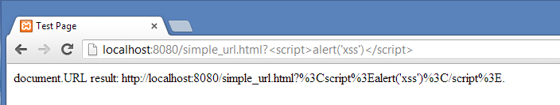
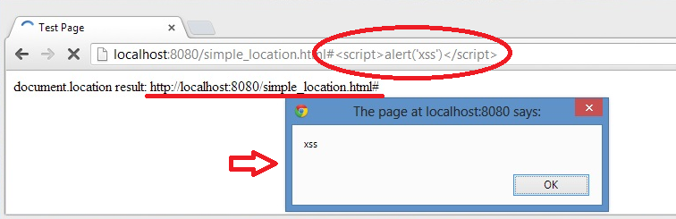
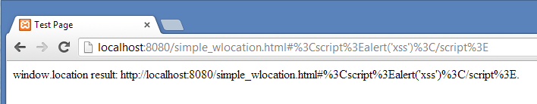
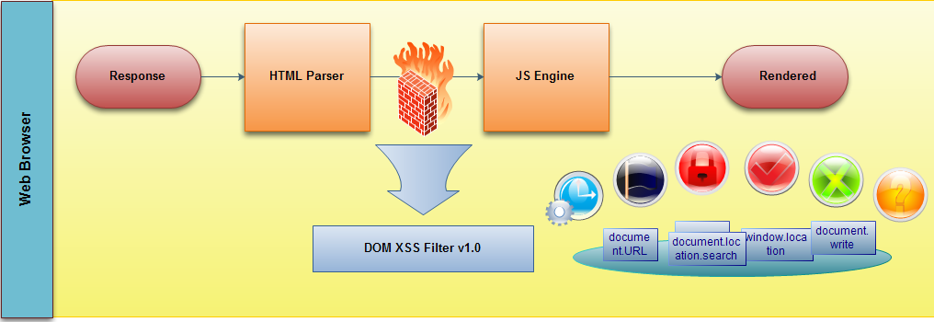
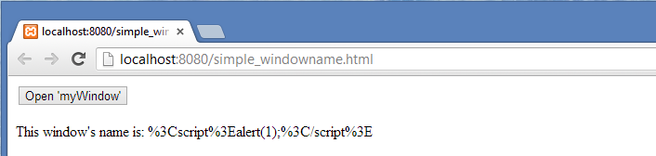
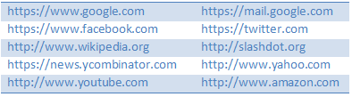
DOM-based XSS Filter
Heryandi, Lu Fangjian, Yang Yuhang, Yang Zhaoyu
School of Computing, National University of Singapore
Web Apps Attack Trends
Approach Overview
Implementation
Browser
Google Chrome 26.0.1410.43 m & 27.0.1453.9 m
JavaScript
Chrome Extension API
chrome.webRequest
Content Script
Result
DOM-based XSS is different from
stored XSS and reflected XSS
Attack is executed entirely within the browser!
Page makes use of unsafe input!
Our Solution: Protect access to unsafe inputs!
Remove Referer from HTTP header
Intercept and remove by chrome.webRequest API
Protection: encode return value
Chrome Content Script
Before complete DOM tree is constructed, inject small amount of JavaScript to…
Override document.URL getter
Override document.URLUnencoded getter
Protect document.location:
document.location.search already encoded
Override document.location.hash getter
Override window.name getter
Force encode window.location.hash
Evaluation
Efficiency: 1.5 page of un-minified code
Flexibility: Plain JavaScript & Chrome API
Compatibility: Tested with 10 websites
Effectiveness: See Result
Goal
Intercept and handle potential vulnerability with minimal impact on user experience.
Efficiency: No significant overhead
Flexibility: Easy to maintain
Compatibility: Compatible with most websites
Effectiveness: Protection from DOM-based XSS

